Slide 1

Car Rental Analysis
Prepared specially for: Lariat Rent-A-Car, Inc.
by DA Kyle Vanburen

Slide 2
Introduction
Lariat-Rent-A-Car, Inc. has enquired a precise analysis for car rental revenue data of the past year
Lariat has 50 branches which spread out across 22 states in the US, but these following states stand out to the rest in branch quantity.
Texas: 10 Branches
California: 8 Branches

Slide 3
Introduction
Lariat, also has a massive variety of 4,000 vehicles which all spread out between the following years.
2016: 1,284 Vehicles
2017: 1,361 Vehicles
2018: 1,355 Vehicles

Slide 4
Goals
Their business management team wants to know what vehicles and branches are outperforming the rest in gross and net revenue. They also want to know what vehicles are rented more frequently and longer.
Their primary business objective is to get strategies on how to minimize cost and maximize profit.

Slide 5
Data Provided
Lariat provided the bellow listed dataset containing four data files of last years business transactions. The dataset includes the following data files:
Car id mapping(correlates a specific id with car manufacture, model, and year)
Car costs(what each cars monthly expenses and insurance cost are)
Car revenue(data of transaction, length of rental, price of rental, branch id, and driver information)
Branch location(branch id (1-50), State, City, and if located in airport T/F)

Slide 6
Analysis Process
With the help of the informational dataset with performing a detailed examination. Key findings have been found and recommended strategies are provided to Lariat.
The following information will be provided on the next few slides.

Slide 7
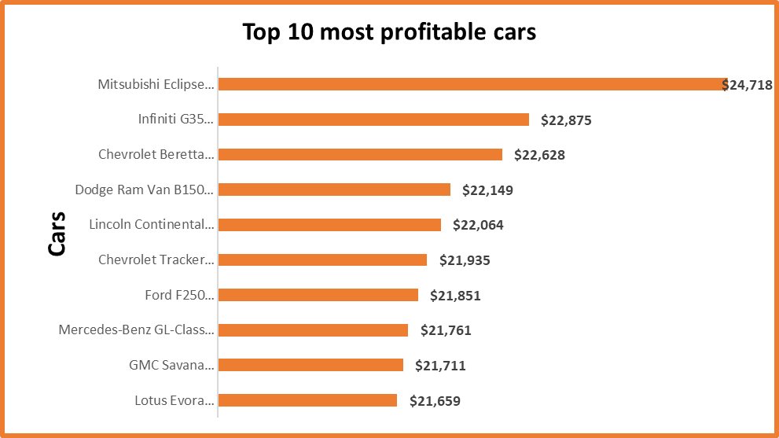
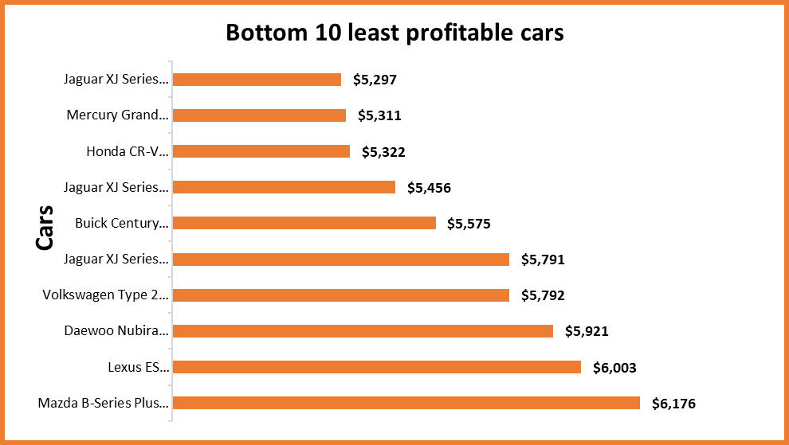
Key Findings
One of the two key revenue findings found in the analysis, is the gross revenue performance of the vehicles.
In which the Mitsubishi Eclipse is the top revenue producing vehicle and the Jaguar XJ Series is the bottom producing vehicle.

Slide 8
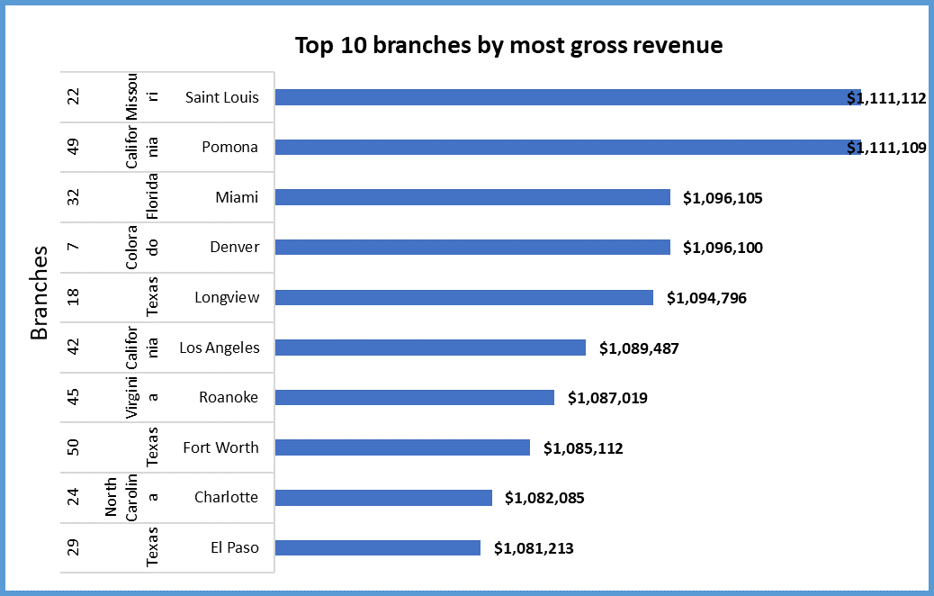
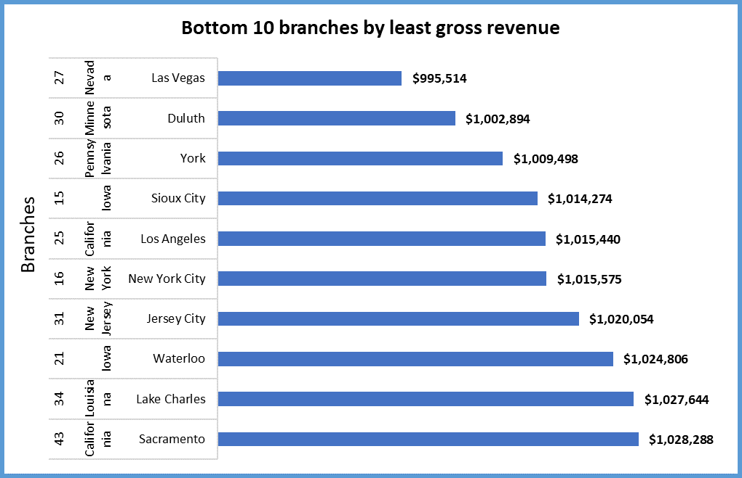
Key Findings
The second of the key findings found during the analysis. Is the gross revenue performance between the branches.
In which Branch #22 located in St. Louis, Missouri performed the best. And Branch #27 located in Las Vegas, Nevada performed the worst.

Slide 9
Strategies
Strategy 1: Perform adjustments to the rental inventory by increasing 20% of vehicles with the best profit margin performance (top 800 vehicles)
The cost of expenses would be higher. However, the net revenue is almost a 5% increase for profit!

Slide 10
Strategies
Strategy 2: Perform adjustments to the rental inventory by selling off 20% or 800 of the vehicles with the worst gross revenue performance
The cost of expenses here shows a noticeable decrease. And the net revenue almost reaches a 5% profit increase.

Slide 11
Strategies
Strategy 3: Combine both strategy 1 & 2 (increase the top 20% and reduce the bottom 20% of vehicles)
This strategy does have a higher expenses cost. With the same quantity of vehicles(4,000). However, it does provide the highest percentage of profit out of all strategies.

Slide 12
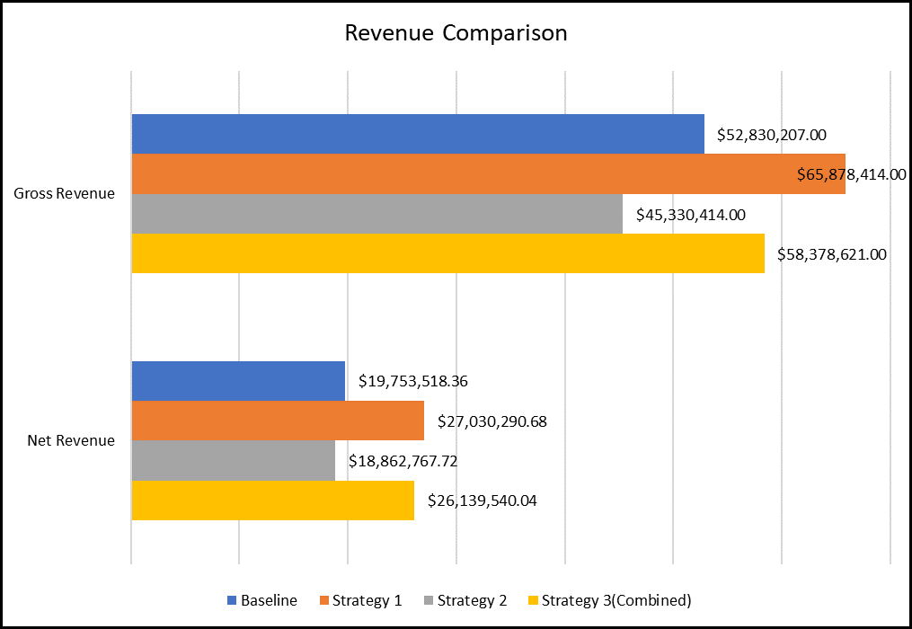
How Strategies Compare
The DA team encourages, based off the main goal. To sell the worst performing vehicles, to see a noticeable cut in cost and a bigger profit return.
However, with less cars on the road expect to see a decline in rental transactions. Here’s a provided link to the workbook with strategies to compare and look at the strategies better for gross and net revenue:

Slide 13
Call to Action
Selling 20% of vehicles would provide the greatest decrease in cost
Adding 20% more vehicles would provide an increase in profit
In doing both you'll get a decrease in cost and an increase in profit.
Taking no action will bring in no decrease of cost, and no increase of profit on vehicles.

Slide 14
Thank you for your time!

